Slide 1

Credit card Fraud Detection
By – Kashish Vaid
Notes:
Please insert direction from slide 1 into slide 2. We would also like to know if we can push out a new version through the PPT toolbar 6 months from now.

Slide 2


Agenda
Problem Statement Discussion
Scope
Expected Outcome
Dataset Introduction
Code Walkthrough
Model Comparison
Recommendations

Slide 3
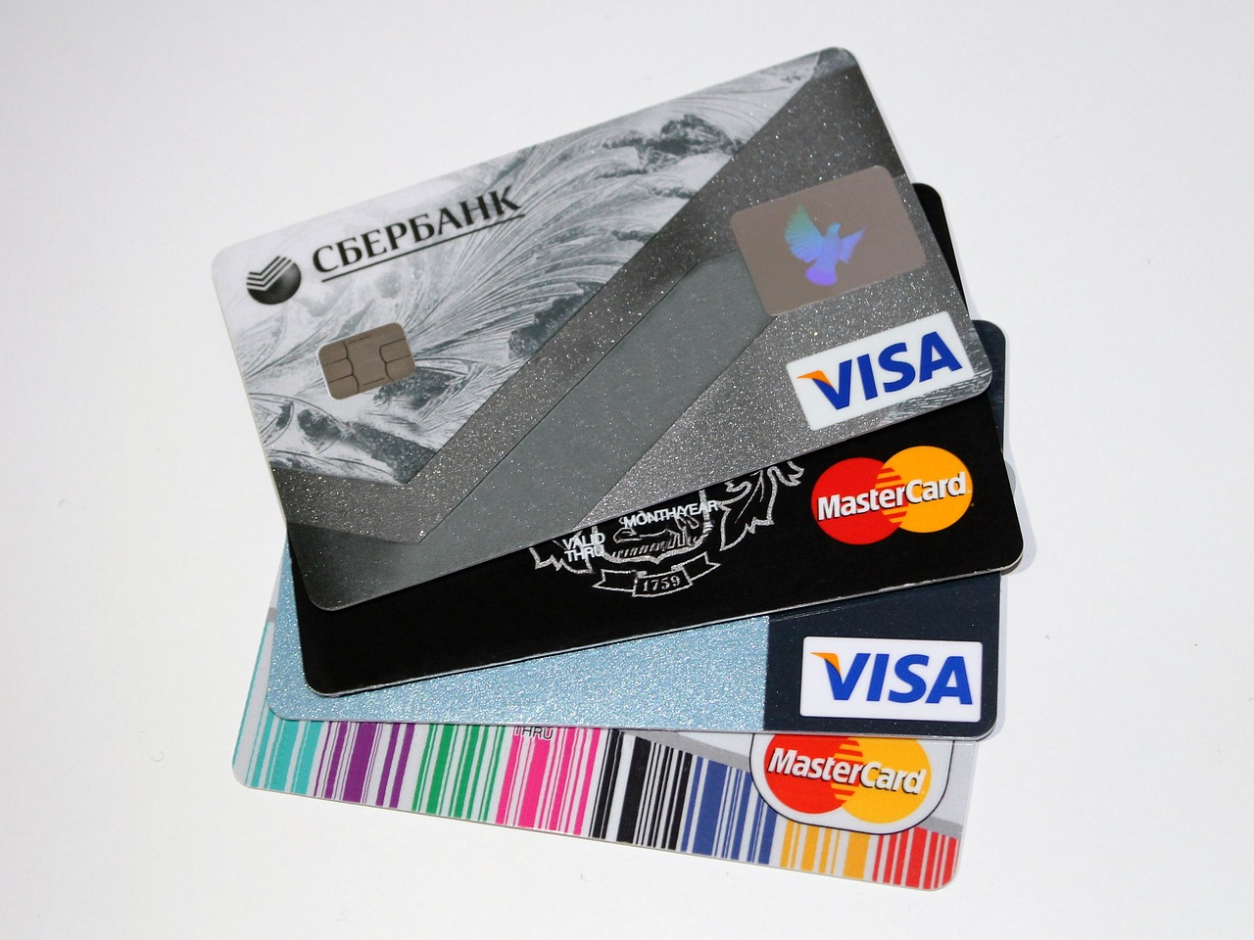
Problem Statement
In the financial sector, fraudulent activities pose a significant threat, leading to substantial monetary losses and undermining customer trust. With the increasing volume of transactions and the sophistication of fraud methods, it is imperative to develop robust systems that can effectively identify and prevent fraudulent activities in real-time.
The primary objective of this project is to develop a predictive model that accurately identifies fraudulent transactions within a dataset of financial transactions. By leveraging data science techniques, we aim to enhance the detection capabilities of fraud detection systems, thereby minimizing financial losses and protecting consumers.
Notes:
Was this part of the original priority 1? We should only have 3 title slide options.
- We had 3 and then I added the instruction slide. I just deleted that one though because I added the instructions to slide 1.

Slide 4
Scope
Data Collection
Data Preprocessing
Exploratory Data Analysis (EDA)
Feature Selection
Feature Engineering: Create new features based on existing data to enhance the predictive power of the models.
Model Development: Apply Random Forest and XGBoost algorithms to classify transactions as fraudulent or legitimate.
Model Evaluation: Assess the performance of the models using metrics such as accuracy, precision, recall, F1-score.

Slide 5

Expected Outcome
-
High-accuracy fraud detection model with minimal false positives.
Automated insights on fraudulent transaction patterns to aid risk management.
Scalable solution that can adapt to new fraud techniques.
Actionable recommendations for businesses to reduce fraud-related risks.
STOP FRAUD

Slide 6


The Fraud Detection Dataset
This dataset is designed to help data scientists and machine learning practitioners develop fraud detection models using binary classification techniques like XGBoost and RandomForest.
🔑 Key Features
✅ 21 diverse features covering transaction details, user behavior, and risk assessment ✅ Realistic structure with numerical, categorical, and temporal data ✅ Binary fraud labels: 0 = Not Fraud, 1 = Fraud ✅ Ideal for anomaly detection, risk analysis, and security research ✅ Features - Transaction ID, User ID, Transaction Amount, Transaction Type, Timestamp, Account Balance and others.
Link : Fraud Detection Transactions Dataset
Notes:
can you provide different options for this slide. Note that we should be able to crop images.

Slide 7
The Approach
Dataset Exploration & Preprocessing
Analyzing the dataset to understand transaction patterns.
Handling missing values, data cleaning, and feature engineering.
ML Model Development
Implementing supervised and unsupervised learning techniques.
Comparing models like Random Forest and XGBoost
Model Evaluation & Optimization
Using precision, recall, F1-score and confusion matrix
Hyperparameter tuning to enhance accuracy
Deployment & Monitoring
Deploying the model as an API or integrating with existing transaction systems
Deployment using FLASK

Slide 8
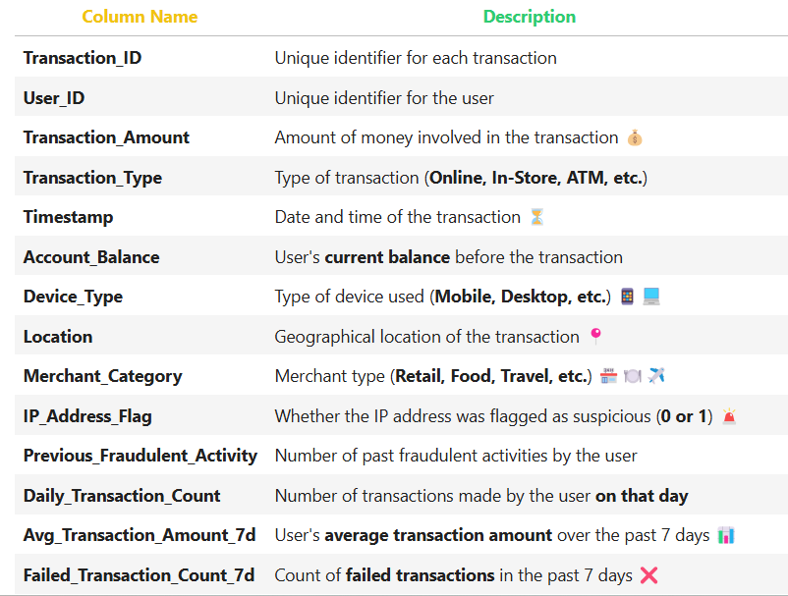
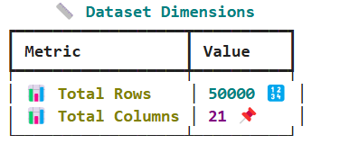
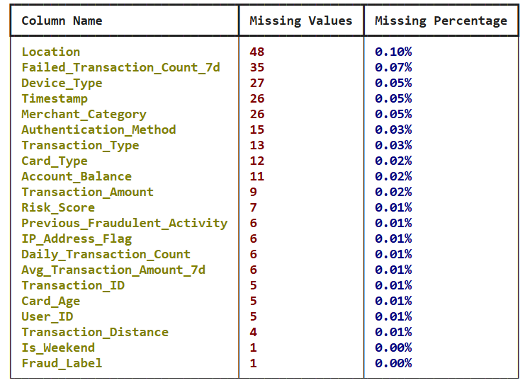
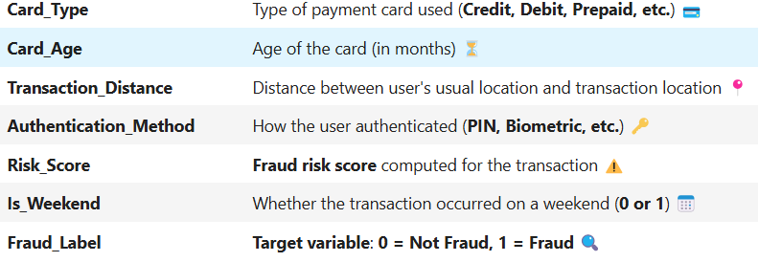
Data Insights

Slide 9
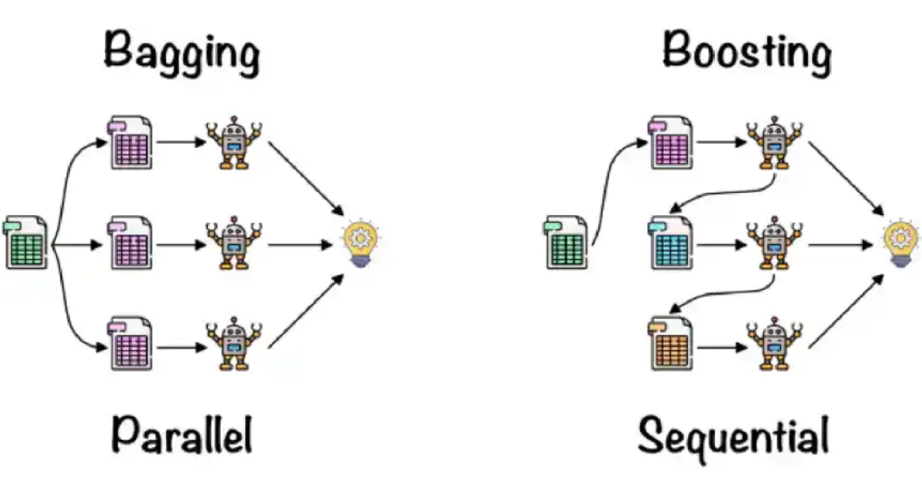
Model Comparison
Random Forest
XGBoost
Random Forest is an ensemble learning method that builds multiple decision trees and merges their results for better accuracy and stability. It helps reduce overfitting and improves generalization.
Bagging technique: Uses bootstrapped samples to train individual trees.
Feature randomness: Each tree gets a random subset of features, reducing correlation.
Strength: Works well for large datasets and handles missing values efficiently.
XGBoost is an advanced gradient boosting algorithm that optimizes speed and performance. It sequentially builds trees while correcting the errors of previous trees.
Boosting technique: Trees are built sequentially, focusing on reducing errors.
Regularization: L1 & L2 regularization prevent overfitting.
Strength: Faster, efficient, and widely used in Kaggle competitions.

Slide 10
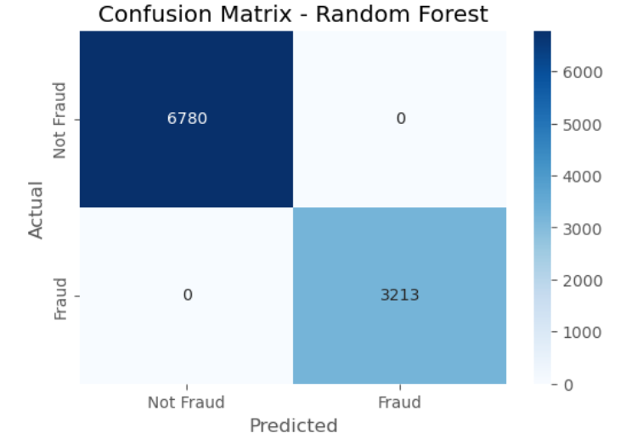
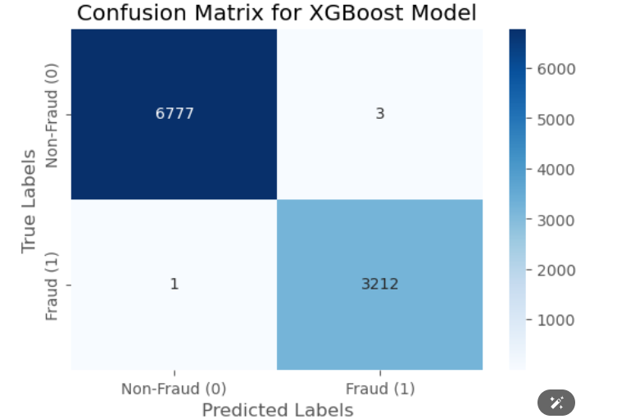
Model Performance
Parameter
Random Forest
XGBoost
Accuracy
Recall
Precision
F1 Score
Confusion Matrix
100%
100%
100%
100%
99.96%
99.91%
99.97 %
99.94%

Slide 11
Recommendations
Fraud cases are usually rare, so class imbalance can lead to the model being biased toward non-fraud cases.
Adjust XGBoost’s scale_pos_weight to give more importance to fraud cases.
Experiment with different loss functions like AUC-PR (Area Under Precision-Recall Curve) instead of accuracy to better handle imbalanced data.
Perform feature importance analysis
Engineer new features such as transaction velocity (number of transactions per hour/day) and merchant credibility scores
Fraud detection should work in real-time to block fraudulent transactions before processing.
Continuously monitor model performance and retrain with fresh data to adapt to new fraud patterns

Slide 12
NEXT STEPS
- Choose between Kafka (large-scale) or API calls (simpler setup) for real-time data. - Twilio or AWS SNS to send SMS fraud alerts. - Optimize Flask with Gunicorn, Redis, and Celery for handling large requests. - Monitor fraud trends with Grafana and retrain the model regularly.

Slide 13
QNA

